Slide 1
— Practice 1 Notes
Machine Learning @ RMIT

Slide 2
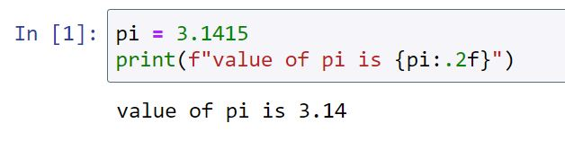
Some housekeeping
Practice recording + solutions will be available following day
You can ask any question…
But… if the question takes me more than 5 minutes to answer, I will probably ask you post your question on the discussion forums
Attendance to practice sessions is 100 % optional
Work during practice sessions will NOT be marked
Reminder: Please install Python 3.6 or above
If this works, it means you have at least Python 3.6 or above:

Slide 3
Expectation management
Practice in week N = hands-on experience from lecture week N-1 + extra cool small tricks
Recommendations:
Review previous lecture materials before the practice
Work on the exercise questions before the practice
Post your questions on the discussion forums before the practice
We might add some new contents to practices to address your questions!

Slide 4
Lectorial Class
Lectorial : Tue 6:30 to 7:25 pm

Slide 5
5 practical sessions (in AEDT)
Prac 1: Tue 5:30 to 6:25 pm
Prac 2: Tue 7:30 to 8:25 pm
Prac 3: Wed 11:30 am to 12:25 pm
Prac 4: Wed 12:30 to 1:25 pm
Prac 5: Wed 1:30 to 2:25 pm

Slide 6


Practices
Course project

Slide 7
Practice session topics
Difficulty level
7
Scikit Learn 2
6
Scikit Learn 1
Data Prep 1
5
Data Prep 2
4
3
Python programming + Numpy + Pandas
2
Formatting Jupyter notebooks
1
Installation
working with Jupyter notebooks
Week

Slide 8


What are we going to use?
Coding platform
Configuration and setup can be very tricky
Coding language

Slide 9




What are we going to use?
Coding platform
+
Coding language
Anaconda is a distribution of data science and machine learning packages

Slide 10
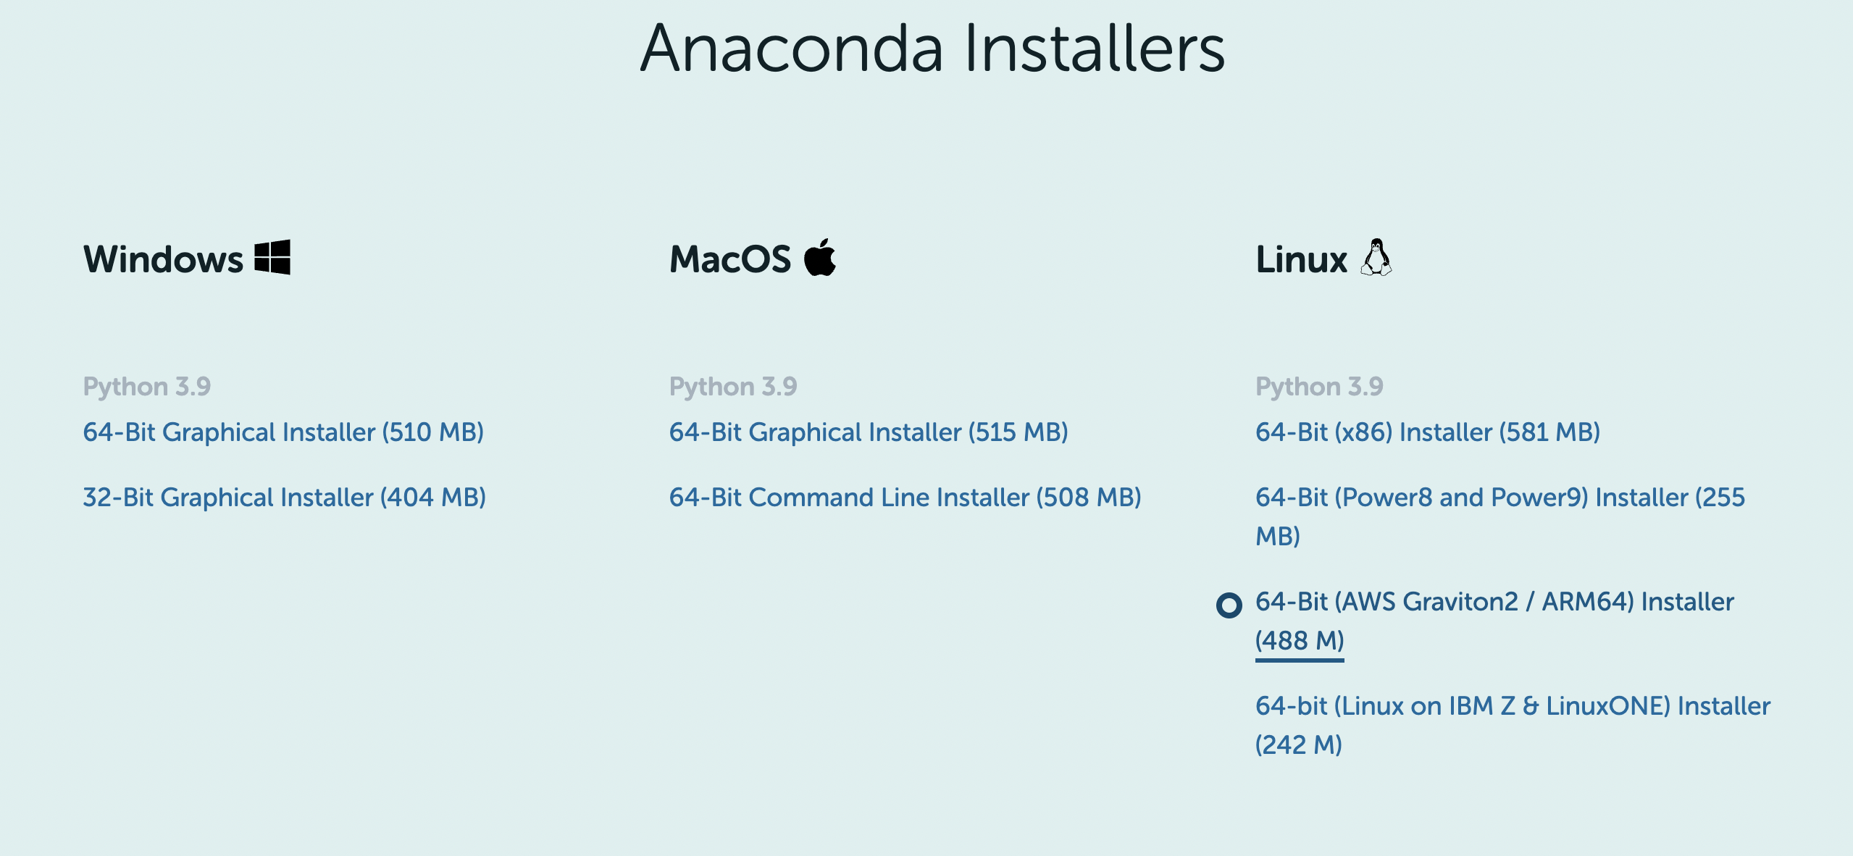
Download Anaconda
https://www.anaconda.com/products/individual

Slide 11
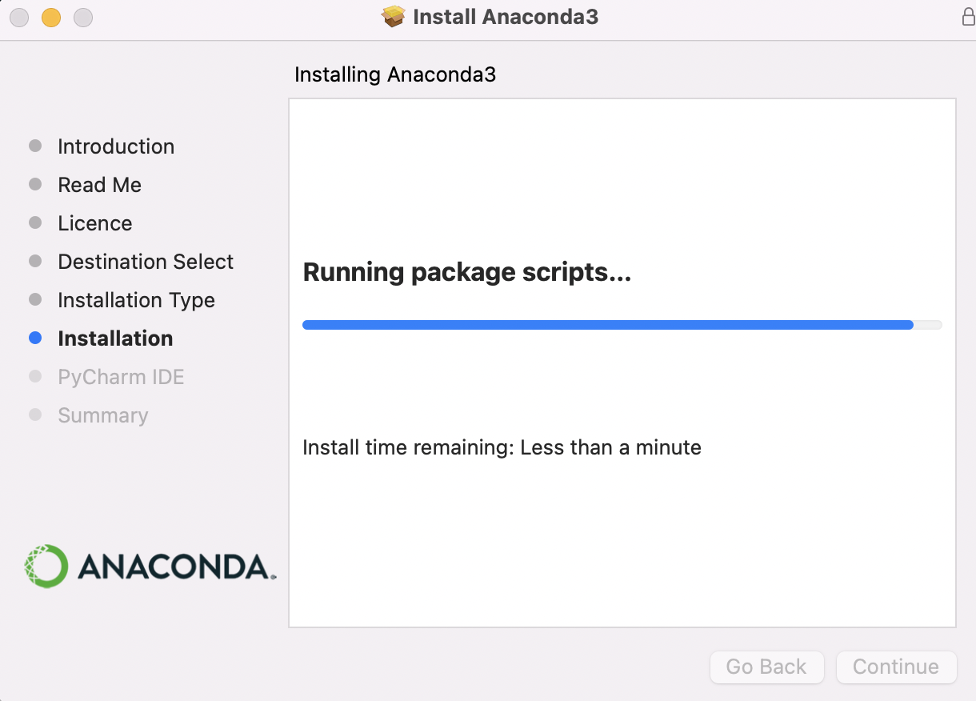
Download Anaconda
Anaconda installer

Slide 12
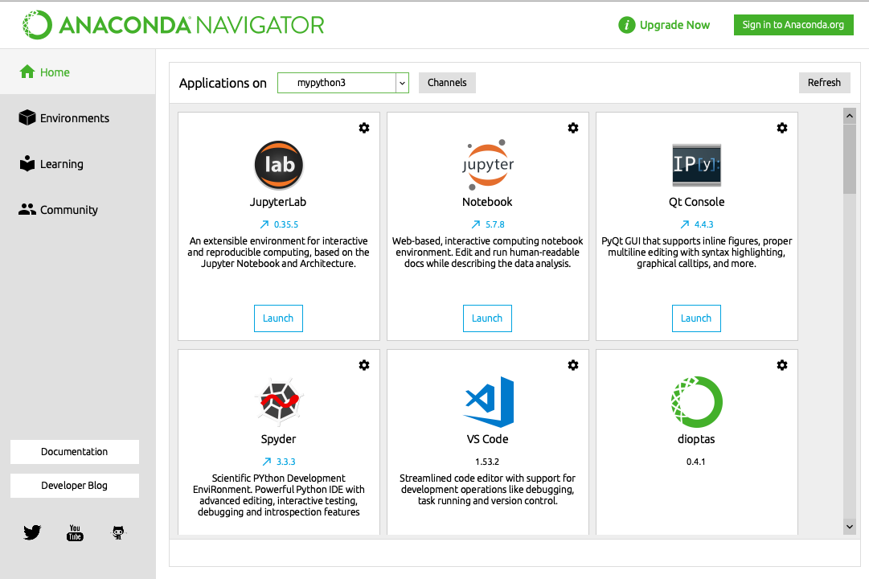
Installation
If you have issues with installation, please first Google them!

Slide 13
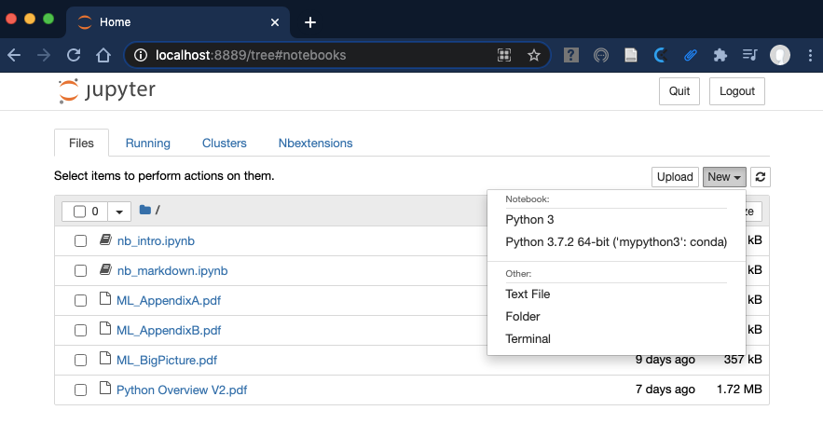
Navigation

Slide 14

Cloud-based tech
https://colab.research.google.com/
Colab by Google

Slide 15
— Let’s switch to

